Slide 1
Cryptography and Network Security
FINITE FIELDS AND NUMBER THEORY
Groups, Rings, and Fields

Slide 2
Session Meta Data
Author | Dr T Sree Sharmila
Reviewer
Version Number | 1.0
Release Date | 26 June 2018

Slide 3
Revision History
Revision Date | Details | Version no.
 |  | 1.0

Slide 4
Agenda
Classical ciphers
Caesar cipher
Monoalphabetic cipher
Playfair cipher
Hill cipher
Polyalphabetic cipher
Rotor machine
Transposition cipher
One time pad
Steganography
Summary
Test your understanding
References

Slide 5
Classical Ciphers
Plaintext is viewed as a sequence of elements (e.g., bits or characters)
Substitution cipher: replacing each element of the plaintext with another element.
Transposition (or permutation) cipher: rearranging the order of the elements of the plaintext.
Product cipher: using multiple stages of substitutions and transpositions
5
Notes:
5

Slide 6
Agenda
Classical ciphers
Caesar cipher
Monoalphabetic cipher
Playfair cipher
Hill cipher
Polyalphabetic cipher
Rotor machine
Transposition cipher
One time pad
Steganography
Summary
Test your understanding
References

Slide 7
Caesar Cipher
Earliest known substitution cipher
Invented by Julius Caesar
Each letter is replaced by the letter three positions further down the alphabet.
Plain: a b c d e f g h i j k l m n o p q r s t u v w x y z
Cipher: D E F G H I J K L M N O P Q R S T U V W X Y Z A B C
Example: ohio state → RKLR VWDWH
7
Notes:
7

Slide 8
Caesar Cipher
8
Mathematically, map letters to numbers:
a, b, c, ..., x, y, z
0, 1, 2, ..., 23, 24, 25
Then the general Caesar cipher is:
c = E_{K}(p) = (p + k) mod 26
p = D_{K}(c) = (c – k) mod 26
Can be generalized with any alphabet.
Notes:
8

Slide 9
Cryptanalysis of Caesar Cipher
9
Key space: {0, 1, ..., 25}
Vulnerable to brute-force attacks.
E.g., break ciphertext "UNOU YZGZK“
Need to recognize it when have the plaintext
What if the plaintext is written in Swahili?
Notes:
9

Slide 10
Agenda
Classical ciphers
Caesar cipher
Monoalphabetic cipher
Playfair cipher
Hill cipher
Polyalphabetic cipher
Rotor machine
Transposition cipher
One time pad
Steganography
Summary
Test your understanding
References

Slide 11
Monoalphabetic Substitution Cipher
Shuffle the letters and map each plaintext letter to a different random ciphertext letter:
Plain letters: abcdefghijklmnopqrstuvwxyz
Cipher letters: DKVQFIBJWPESCXHTMYAUOLRGZN
Plaintext: ifwewishtoreplaceletters
Ciphertext: WIRFRWAJUHYFTSDVFSFUUFYA
What does a key look like?
11
Notes:
11

Slide 12
Monoalphabetic Cipher Security
Now we have a total of 26! = 4 x 10²⁶ keys.
With so many keys, it is secure against brute-force attacks.
But not secure against some cryptanalytic attacks.
Problem is language characteristics.
12
Notes:
12

Slide 13
Language Statistics and Cryptanalysis
13
Human languages are not random.
Letters are not equally frequently used.
In English, E is by far the most common letter, followed by T, R, N, I, O, A, S.
Other letters like Z, J, K, Q, X are fairly rare.
There are tables of single, double & triple letter frequencies for various languages
Notes:
13

Slide 14
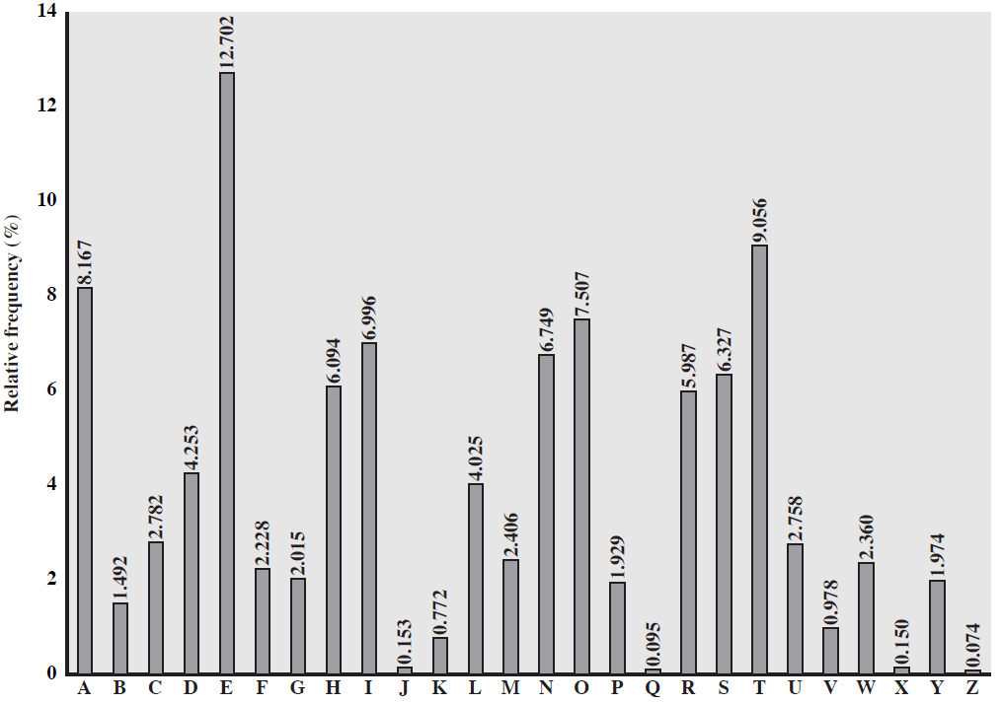
English Letter Frequencies
14
Notes:
14

Slide 15
Statistics for double & triple letters
In decreasing order of frequency
Double letters:
th he an in er re es on, …
Triple letters:
the and ent ion tio for nde, …
15

Slide 16
Use in Cryptanalysis
Key concept: monoalphabetic substitution does not change relative letter frequencies
To attack, we
calculate letter frequencies for ciphertext
compare this distribution against the known one
16
Notes:
16

Slide 17
Example Cryptanalysis
Given ciphertext:
UZQSOVUOHXMOPVGPOZPEVSGZWSZOPFPESXUDBMETSXAIZ
VUEPHZHMDZSHZOWSFPAPPDTSVPQUZWYMXUZUHSX
EPYEPOPDZSZUFPOMBZWPFUPZHMDJUDTMOHMQ
Count relative letter frequencies (see next page)
Guess {P, Z} = {e, t}
Of double letters, ZW has highest frequency, so guess ZW = th and hence ZWP = the
Proceeding with trial and error finally get:
it was disclosed yesterday that several informal but
direct contacts have been made with political
representatives of the viet cong in moscow
17
Notes:
17

Slide 18
Letter frequencies in ciphertext
P 13.33 | H 5.83 | F 3.33 | B 1.67 | C 0.00
Z 11.67 | D 5.00 | W 3.33 | G 1.67 | K 0.00
S 8.33 | E 5.00 | Q 2.50 | Y 1.67 | L 0.00
U 8.33 | V 4.17 | T 2.50 | I 0.83 | N 0.00
O 7.50 | X 4.17 | A 1.67 | J 0.83 | R 0.00
M 6.67
18

Slide 19
Agenda
Classical ciphers
Caesar cipher
Monoalphabetic cipher
Playfair cipher
Hill cipher
Polyalphabetic cipher
Rotor machine
Transposition cipher
One time pad
Steganography
Summary
Test your understanding
References

Slide 20
Playfair Cipher
Not even the large number of keys in a monoalphabetic cipher provides security.
One approach to improving security is to encrypt multiple letters at a time.
The Playfair Cipher is the best known such cipher.
Invented by Charles Wheatstone in 1854, but named after his friend Baron Playfair.
20
Notes:
20

Slide 21
Playfair Key Matrix
Use a 5 x 5 matrix.
Fill in letters of the key (w/o duplicates).
Fill the rest of matrix with other letters.
E.g., key = MONARCHY.
M | O | N | A | R
C | H | Y | B | D
E | F | G | I/J | K
L | P | Q | S | T
U | V | W | X | Z
21
Notes:
21

Slide 22
Encrypting and Decrypting
Plaintext is encrypted two letters at a time.
If a pair is a repeated letter, insert filler like 'X’.
BALLOON→ BA LX LO ON
If both letters fall in the same row, replace each with the letter to its right (circularly). AR→RM
If both letters fall in the same column, replace each with the letter below it (circularly). MU→CM
Otherwise, each the letter is replaced by the letter in the same row but in the column of the other letter of the pair. HS→BP & EA→IM (or JM)
22
Notes:
22

Slide 23
Security of Playfair Cipher
Equivalent to a monoalphabetic cipher with an alphabet of 26 x 26 = 676 characters.
Security is much improved over the simple monoalphabetic cipher.
Was widely used for many decades
eg. by US & British military in WW1 and early WW2
Once thought to be unbreakable.
Actually, it can be broken, because it still leaves some structure of plaintext intact.
23
Notes:
23

Slide 24
Agenda
Classical ciphers
Caesar cipher
Monoalphabetic cipher
Playfair cipher
Hill cipher
Polyalphabetic cipher
Rotor machine
Transposition cipher
One time pad
Steganography
Summary
Test your understanding
References

Slide 25
Hill Cipher
Takes two or three or more letter combinations to the same size combinations, e.g. “the” → “rqv”
Uses simple linear equations
An example of a “block” cipher encrypting a block of text at a time
Numbered alphabet: a = 0, b = 1, c = 3, etc. (in CAP, use ASCII code)

Slide 26
Example
C1 = 9*p1 + 18*p2 + 10*p3 (mod 26)
C2 = 16*p1 + 21*p2 + 1*p3 (mod 26)
C3 = 5*p1 + 12*p2 + 23*p3 (mod 26)
C1 9 18 10 p1
C2 = 16 21 1 p2 (mod 26)
C3 5 12 23 p3

Slide 27
I can’t do it
8 2 0 13 19 3 14 8 19
→ EOM TMY SVJ
4 9 18 10 8
14 = 16 21 1 2 (mod 26)
12 5 12 23 0
19 9 18 10 13
12 = 16 21 1 19 (mod 26)
14 5 12 23 3
18 9 18 10 14
21 = 16 21 1 8 (mod 26)
9 5 12 23 19

Slide 28
Hill – key is matrix
k11 k12 k13
k21 k22 k23
k31 k32 k33
Generalize to any size, larger blocks
Matrix must be invertible

Slide 29
Agenda
Classical ciphers
Caesar cipher
Monoalphabetic cipher
Playfair cipher
Hill cipher
Polyalphabetic cipher
Rotor machine
Transposition cipher
One time pad
Steganography
Summary
Test your understanding
References

Slide 30
Polyalphabetic Substitution Ciphers
30
A sequence of monoalphabetic ciphers (M₁, M₂, M₃, ..., M_{k}) is used in turn to encrypt letters.
A key determines which sequence of ciphers to use.
Each plaintext letter has multiple corresponding ciphertext letters.
This makes cryptanalysis harder since the letter frequency distribution will be flatter.
Notes:
30

Slide 31
Vigenère Cipher
31
Simplest polyalphabetic substitution cipher
Consider the set of all Caesar ciphers:
{ C_{a}, C_{b}, C_{c}, ..., C_{z} }
Key: e.g. security
Encrypt each letter using C_{s}, C_{e}, C_{c}, C_{u}, C_{r}, C_{i}, C_{t}, C_{y} in turn.
Repeat from start after C_{y}.
Decryption simply works in reverse.
Notes:
31

Slide 32
Example of Vigenère Cipher
32
Keyword: deceptive
key: deceptivedeceptivedeceptive
plaintext: wearediscoveredsaveyourself
ciphertext: ZICVTWQNGRZGVTWAVZHCQYGLMGJ
Notes:
32

Slide 33
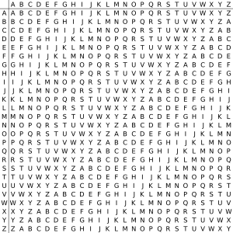
Vigenère Cipher

Slide 34
Security of Vigenère Ciphers
There are multiple (how many?) ciphertext letters corresponding to each plaintext letter.
So, letter frequencies are obscured but not totally lost.
To break Vigenere cipher:
Try to guess the key length. How?
If key length is N, the cipher consists of N Caesar ciphers. Plaintext letters at positions k, N+k, 2N+k, 3N+k, etc., are encoded by the same cipher.
Attack each individual cipher as before.
34
Notes:
34

Slide 35
Guessing the Key Length
Main idea: Plaintext words separated by multiples of the key length are encoded in the same way.
In our example, if plaintext = “…thexxxxxxthe…” then “the” will be encrypted to the same ciphertext words.
So look at the ciphertext for repeated patterns.
E.g. repeated “VTW” in the previous example suggests a key length of 3 or 9:
ciphertext: ZICVTWQNGRZGVTWAVZHCQYGLMGJ
Of course, the repetition could be a random fluke.
35
Notes:
35

Slide 36
Agenda
Classical ciphers
Caesar cipher
Monoalphabetic cipher
Playfair cipher
Hill cipher
Polyalphabetic cipher
Rotor machine
Transposition cipher
One time pad
Steganography
Summary
Test your understanding
References

Slide 37
Rotor Cipher Machines
Before modern ciphers, rotor machines were most common complex ciphers in use.
Widely used in WW2.
Used a series of rotating cylinders.
Implemented a polyalphabetic substitution cipher of period K.
With 3 cylinders, K = 26³ =17,576.
With 5 cylinders, K = 26⁵ =12 x 10⁶.
What is a key?
If the adversary has a machine
If the adversary doesn’t have a machine
37
Notes:
37

Slide 38
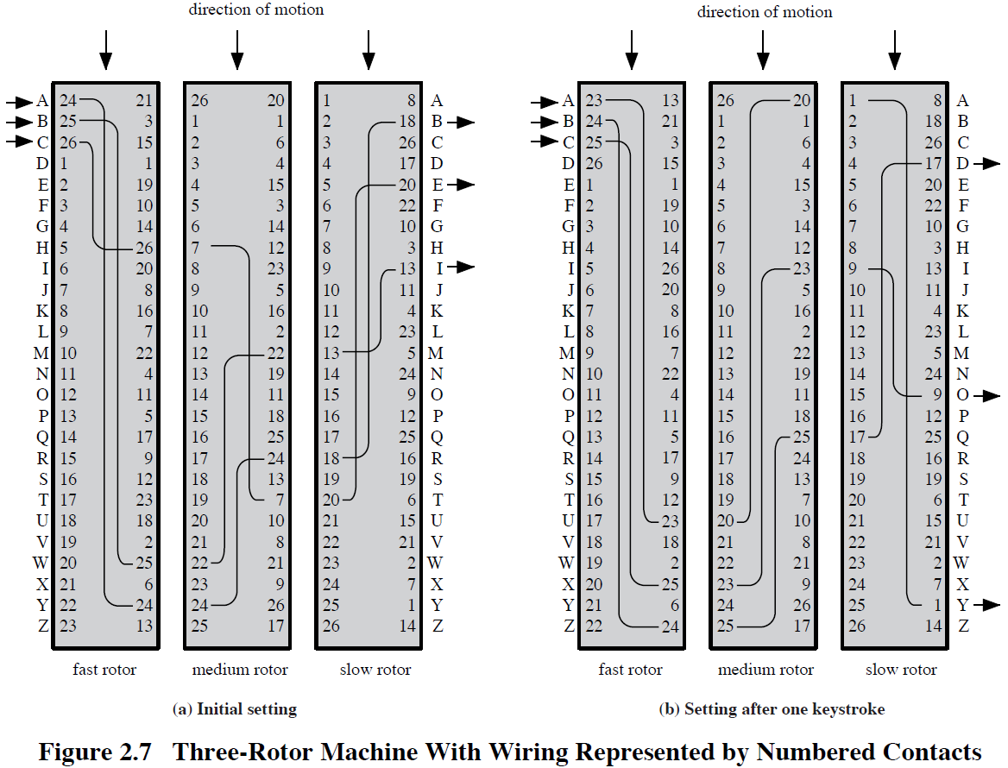
Rotor Cipher Machines
38

Slide 39
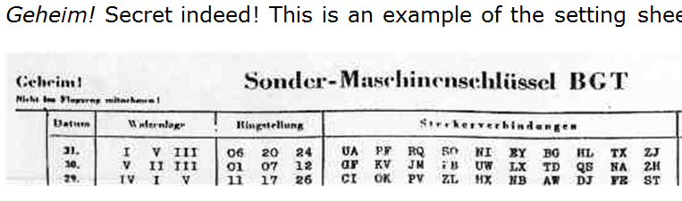
German secret setting sheets
Date
Which rotors to use (there were 10 rotors)
Ring setting
Plugboard setting
39

Slide 40
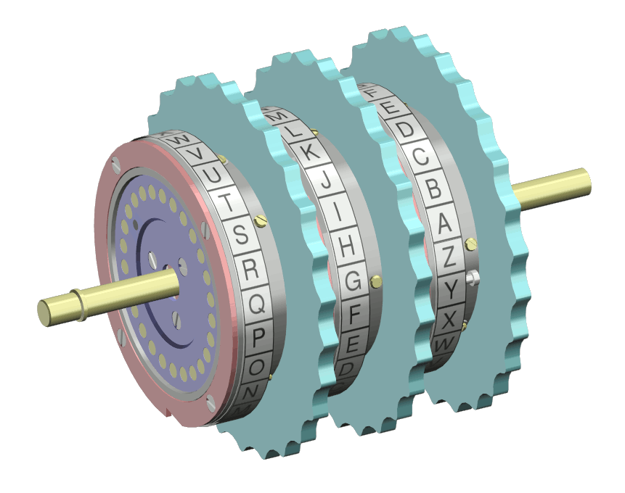
The Rotors
40
Notes:
40

Slide 41
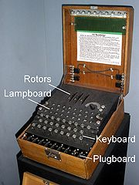
Enigma Rotor Machine
41
Notes:
41

Slide 42
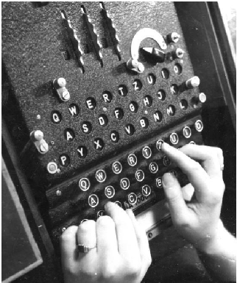
Enigma Rotor Machine
42
Notes:
42

Slide 43
Agenda
Classical ciphers
Caesar cipher
Monoalphabetic cipher
Playfair cipher
Hill cipher
Polyalphabetic cipher
Rotor machine
Transposition cipher
One time pad
Steganography
Summary
Test your understanding
References

Slide 44
Transposition Ciphers
44
Also called permutation ciphers.
Shuffle the plaintext, without altering the actual letters used.
Example: Row Transposition Ciphers
Notes:
44

Slide 45
Row Transposition Ciphers
Plaintext is written row by row in a rectangle.
Ciphertext: write out the columns in an order specified by a key.
Key: 3 4 2 1 5 6 7
Plaintext:
Ciphertext: TTNAAPTMTSUOAODWCOIXKNLYPETZ
a | t | t | a | c | k | p
o | s | t | p | o | n | e
d | u | n | t | i | l | t
w | o | a | m | x | y | z
45
Notes:
45

Slide 46
Agenda
Classical ciphers
Caesar cipher
Monoalphabetic cipher
Playfair cipher
Hill cipher
Polyalphabetic cipher
Rotor machine
Transposition cipher
One time pad
Steganography
Summary
Test your understanding
References

Slide 47
Product Ciphers
Uses a sequence of substitutions and transpositions
Harder to break than just substitutions or transpositions
This is a bridge from classical to modern ciphers.
47
Notes:
47

Slide 48
Unconditional & Computational Security
A cipher is unconditionally secure if it is secure no matter how much resources (time, space) the attacker has.
A cipher is computationally secure if the best algorithm for breaking it will require so much resources (e.g., 1000 years) that practically the cryptosystem is secure.
All the ciphers we have examined are not unconditionally secure.
48

Slide 49
An unconditionally Secure Cipher
49

Slide 50
One-time Pad
Use a random key as long as the message. Must not reuse the key sequence ever again.
Both parties must have key sequence
Hotline between USA and USSR was rumoured to use a one-time pad.
Destroy key sequence after use
EXAMPLE Key is number of places to shift letter K 321424 P launch C OCVREL
Suggest a good 1-time pad function for binary data?

Slide 51
Agenda
Classical ciphers
Caesar cipher
Monoalphabetic cipher
Playfair cipher
Hill cipher
Polyalphabetic cipher
Rotor machine
Transposition cipher
One time pad
Steganography
Summary
Test your understanding
References

Slide 52
Steganography
Hide a message in another message.
E.g., hide your plaintext in a graphic image
Each pixel has 3 bytes specifying the RGB color
The least significant bits of pixels can be changed w/o greatly affecting the image quality
So can hide messages in these LSBs
Advantage: hiding existence of messages
Drawback: high overhead
52
Notes:
52

Slide 53
Agenda
Classical ciphers
Caesar cipher
Monoalphabetic cipher
Playfair cipher
Hill cipher
Polyalphabetic cipher
Rotor machine
Transposition cipher
One time pad
Steganography
Summary
Test your understanding
References

Slide 54
Summary
Understand the operation of monoalphabetic substitution cipher
Understand the operation of a polyalphabetic cipher
Present an overview of Playfair and Hill cipher
Describe the operation of a rotor machine

Slide 55
Agenda
Classical ciphers
Caesar cipher
Monoalphabetic cipher
Playfair cipher
Hill cipher
Polyalphabetic cipher
Rotor machine
Transposition cipher
One time pad
Steganography
Summary
Test your understanding
References

Slide 56
Test your understanding
Discuss the model for network security
Define cryptography.
Define cryptanalysis.
What is deciphering?
What is enciphering?
Explain different substitution and transposition techniques.

Slide 57
Agenda
Classical ciphers
Caesar cipher
Monoalphabetic cipher
Playfair cipher
Hill cipher
Polyalphabetic cipher
Rotor machine
Transposition cipher
One time pad
Steganography
Summary
Test your understanding
References

Slide 58
References
1. William Stallings, Cryptography and Network Security, 6th Edition, Pearson Education, March 2013.
2. Charlie Kaufman, Radia Perlman and Mike Speciner, “Network Security”, Prentice Hall of India, 2002.

